Slide 1
Healthcare Management System
Submitted To: Submitted By:
Khan Md. Hasib Name: Sheikh Afrin
Lecturer , Department of CSE ID: UG02-47-18-040
State University Of Bangladesh

Slide 2
ABSTRACT
A health care management system is a system integrated into hospitals or clinics for managing several operations while increasing their efficiency.
Healthcare Management system can transform the overall working of hospitals, clinics or individual practices.
Today, with technological advancements, the patients expect fast and top-quality medical services. In such era, it is a smart and competitive decision for organizations to adopt a modern system the efficiently manages daily tasks and resources.

Slide 3
THE TECHNOLOGIES USE IN THIS PROJECT ARE
Language Used : PHP
Database : My SQL
User Interface Design : HTML, AJAX,JQUERY,JAVASCRIPT
Web Browser : Mozilla, Google Chrome, OPERA
Software : XAMPP Server

Slide 4
FEATURES
Login Systems (Patients/Admin/Doctor)
Book Appointment
Manage Patients, Doctors
Add Doctor Specialization
Useful For:
Large, Medium, Hospitals and Nursing Homes
Physicians, Surgeons, Gynecologist

Slide 5
MODULES
Healthcare Management system is a web application for the hospital which manages doctors and patients. In this project, we use PHP and MySQL database.
The entire project mainly consists of 3 modules, which are
Admin module
User(Patient) module
Doctor module

Slide 6
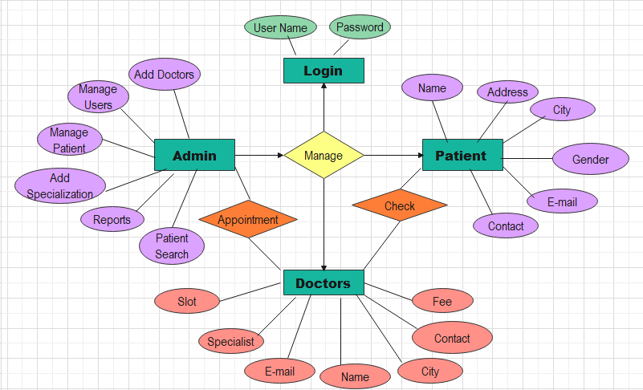
ER DIAGRAM

Slide 7

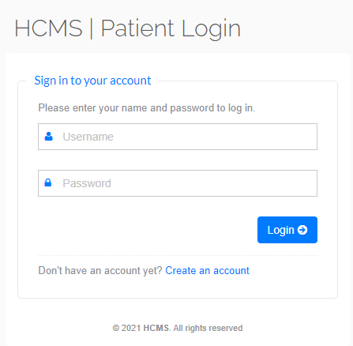
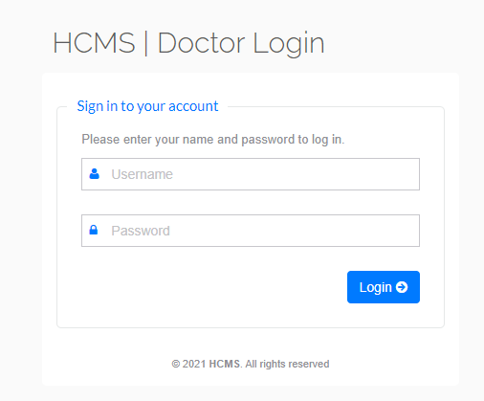
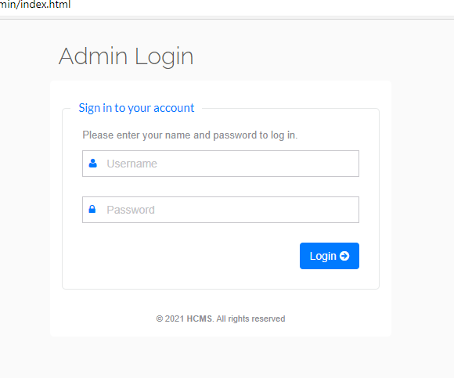
Features Of Modules
Patients Login Page
Doctor Login Page
Admin Login Page

Slide 8
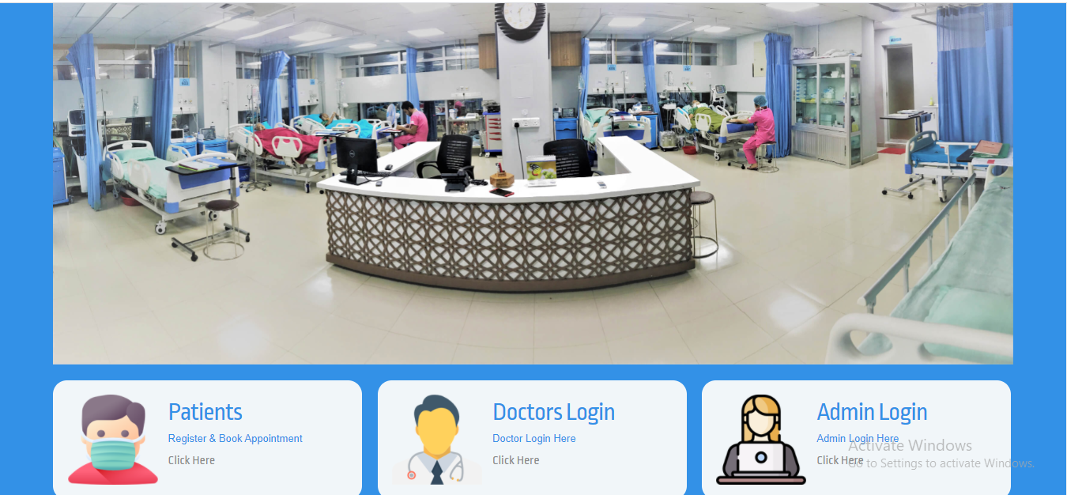
Home Page

Slide 9
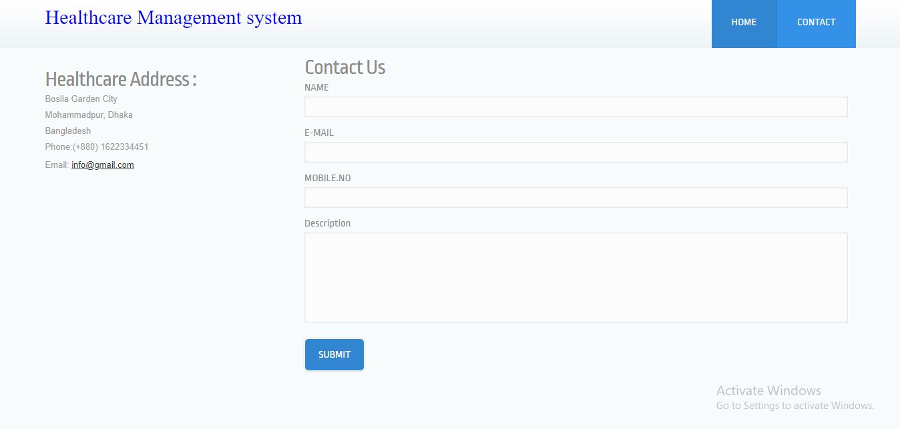
CONTACT PAGE

Slide 10
Significant advantages of a Healthcare Management System
Healthcare management system acts as a patient scheduler system using which the patient can book an appointment. The doctor can update their available slots.
Recording of medical data becomes easy which allows doctors to treat the patients more effectively improving the quality of healthcare services.
It helps to automate internal processes along with data-entry, administrative and other repetitive tasks. Automating these tasks saves the time and efforts of care providers and medical staff.
Healthcare management system long with help the organizations to make better clinical decisions.
It improves the patient satisfaction which in turn improves the overall ratings and reputation of the organization.

Slide 11
CONCLUSION
This system makes easy management of healthcare for the patients as well as doctors. The design of this project is pretty simple and the user won’t find it difficult to understand, use and navigate. An advanced Healthcare management system allows medical organization to become more productive and improve competitiveness.

